Slide 1

NHibernate Fundamentals
1 – Overview and Fundamentals

Slide 2
Overview
What is NHibernate?
Where do I get it?
Supported databases
OO vs Relational
Mapping concepts
NHibernate API
Adding NHibernate to a Project

Slide 3
What is NHibernate?
Open-source .NET ORM
Based on Hibernate, Java ORM
Mature, active project

Slide 4
Where do I get it?
http://nhibernate.info/
NuGet

Slide 5
ORM/NHibernate Benefits
Productivity
Eliminates repetitive code
Generate schema automatically
Maintainability
Fewer lines of code
Performance
Lazy loading
Database Independence
Abstract DB away
Can configured outside the app
Caching
No manual mapping
Optimizes DB Access
Worry about model, not DB

Slide 6
Supported databases
SQL Server | Oracle | DB2 | Firebird
Informix | Ingres | MySQL | PostgreSQL
SQLite | Sybase | Any ODBC | Any OleDB

Slide 7
OO vs Relational
OO | Relational
Objects | Sets
Unidirectional Associations | Bidirectional Associations
Pointer from owner | Foreign Keys
Inheritance | None
Polymorhpism | None
M:M | Join Tables

Slide 8
Mapping concepts
Class Definition
Mapping Metadata
Database Schema

Slide 9
Metadata mapping
XML files
Attributes
Fluent API and code mappings (we’ll mostly use this)
CONForm (convention based)

Slide 10
My $0.02
Code mappings are best
Keep your classes as POCO as much as possible

Slide 11
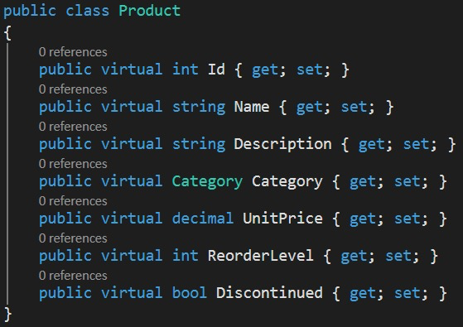
POCO Domain classes
No special persistence-related base class
No interfaces or attributes
Some advanced cases use a base entity class

Slide 12
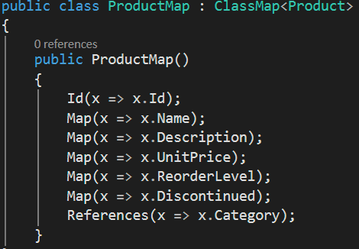
Code-based Mapping

Slide 13
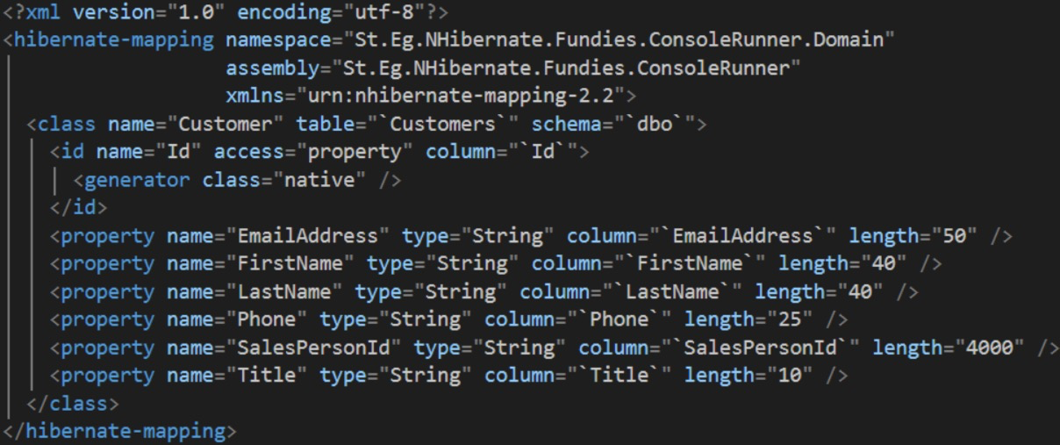
XML Mapping

Slide 14
API
Configuration | Class for bootstrapping
ISessionFactory | Factory for creating sessions
ISession | Database connections
ITransaction | Transactions
IQuery | String-based query (HQL)
ICriteria | Object-based query
LINQ | LINQ-based query

Slide 15
Session Factory
Point of retrieval for session objects
Expensive, so use as little as possible
Setup management of changes and connections to DB

Slide 16
Tools
http://www.llblgen.com/
NHibernate Profiler: http://www.hibernatingrhinos.com/products/nhprof
https://visualstudiogallery.msdn.microsoft.com/0d2cf5b7-d927-49d5-bf9a-9013a2bdecf6

Slide 17
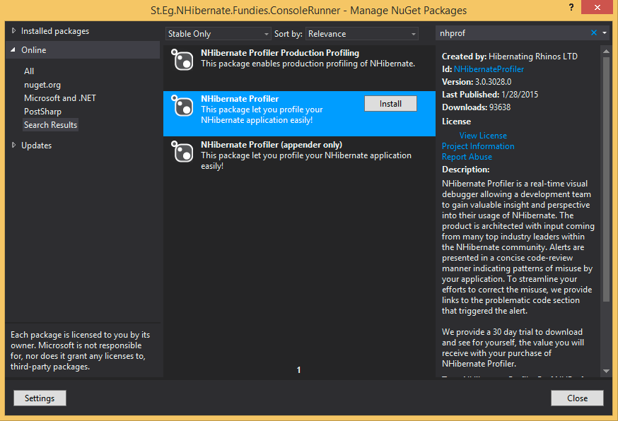
Nhibernate Profiler

Slide 18
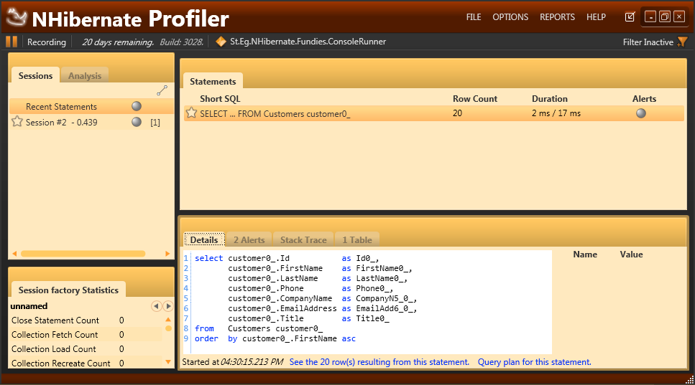

Slide 19
Demo
Create project, add references, empty database
Define Single Entity Customer
Create Mappings
Create the database objects
Make a session factory
Open the session
Add two Customers to the database
Load customer2 from the database
Query a customer

Slide 20
Summary
Overview of Nhibernate
The OO vs RDBMS gap
Mapping concepts
The main objects of the API
Show basic operations in a demo with NHibernate

Slide 21
Lab
Create an empty database
Define connection string
Create a Customer entity
Create mappings
Create the database with NHibernate
Insert a customer
Retrieve customers

